Slide 1
Intro to AngularJS
Sam Helman
Software Engineer, MongoDB Inc.

Slide 2
Clone repo

Slide 3

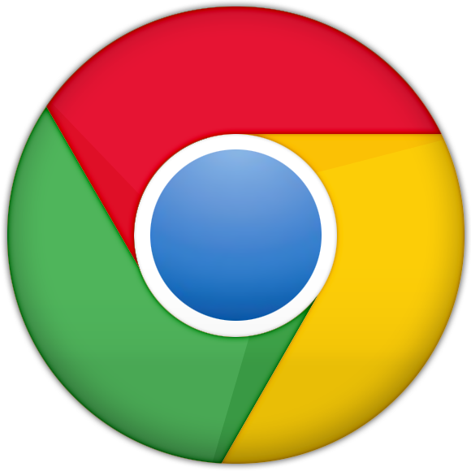
Where AngularJS fits in
1. http://www.yoursite.com/users
2. Give me yoursite.com/users
4. Here’s users.html
5. Request .css and .js files
3. Find / create users.html
6. Apply css, render html
7. Execute javascript

Slide 4
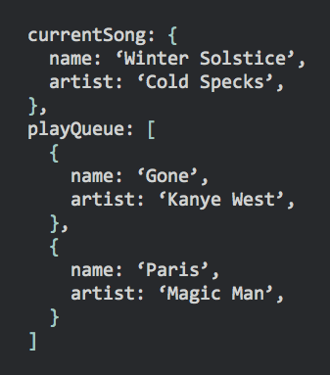
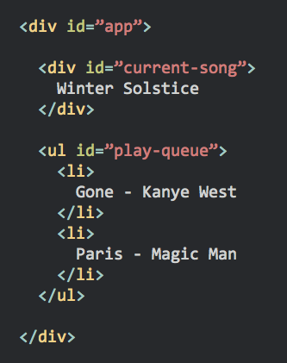

Model
View
±
Controller
Server

Slide 5








Other Frameworks

Slide 6
Code...

Slide 7
More Cool Stuff
(that we didn’t get to today)

Slide 8
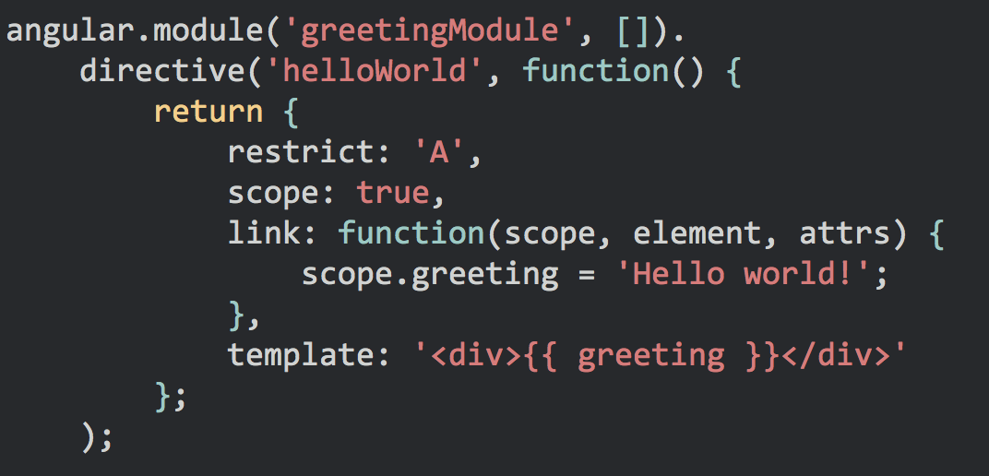

Directives

Slide 9
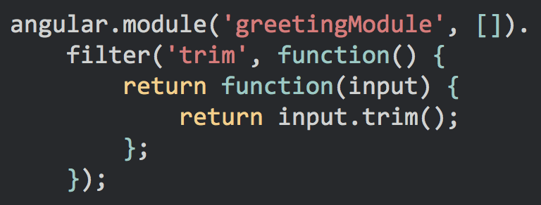

Filters (write your own)

Slide 10
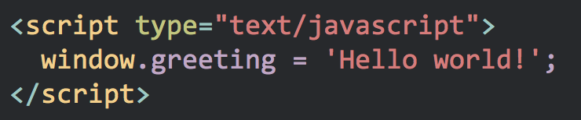
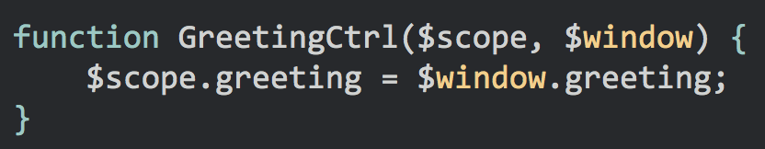
Loading data server-side

Slide 11
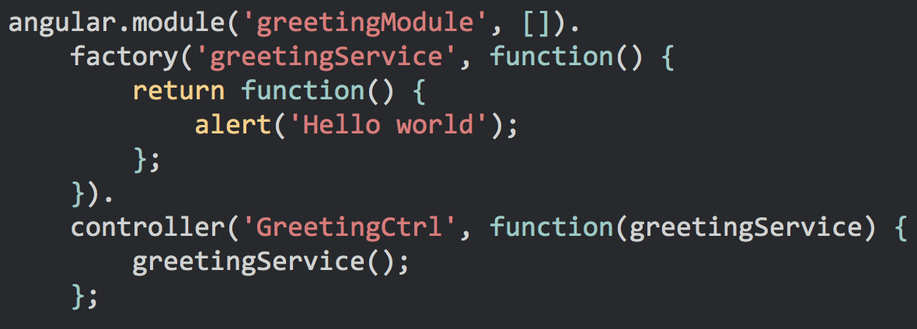
Services (write your own)

Slide 12
Useful Libraries / Modules
ngResource
module for creating RESTful models
ui-bootstrap
angularjs-compatible bootstrap components
ui-router
excellent routing library

Slide 13
Additional Resources

Slide 14
Frameworks
Understanding JS MVC Frameworks
TodoMVC
Choosing a Javascript MVC Framework

Slide 15
Other AngularJS Tutorials
AngularJS Fundamentals in 60-ish Minutes
Official AngularJS Tutorial
Intro to AngularJS in 50 Examples
egghead.io videos
10,000 word Angularjs tutorial

Slide 16
General Info
Official docs
AngularJS-Learning
Angularjs cheat sheet

Slide 17
Thanks!

